Slide 1
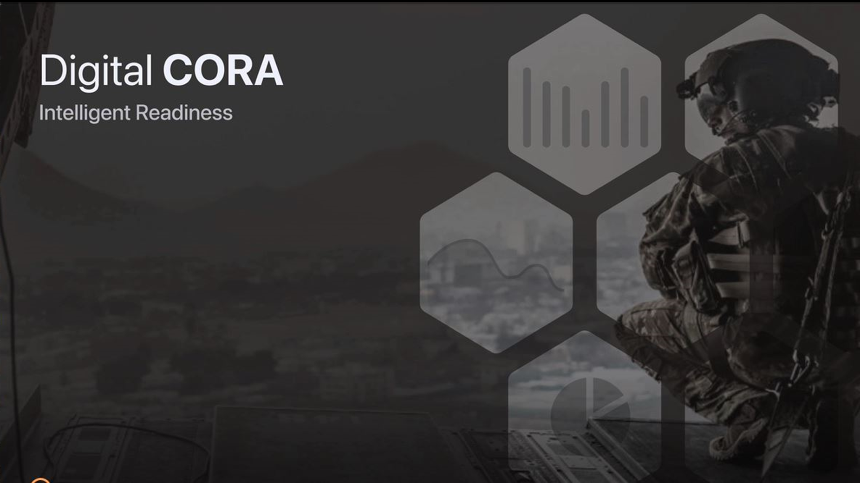
Comprehensive and Continuous Mental and Physical Status Measurement of Pre- and Post-Deployment Warfighters with Mobile Application
Principal Investigator: Dr. Leslie Saxon, MD
University of Southern California, Center for Body Computing (CBC)
Award Number(s): 53-0821-5819 & 53-0821-5823
Contract/Grant Number: W911NF-14-D-0005-0008 Award Period of Performance (10/2020 – 12/2021) Award Amount: $4,308,831
Co-Investigators: Mona Sobhani, Ph.D.
Rob Faulk, PT, DPT, CSCS
Human Performance Director

Slide 2
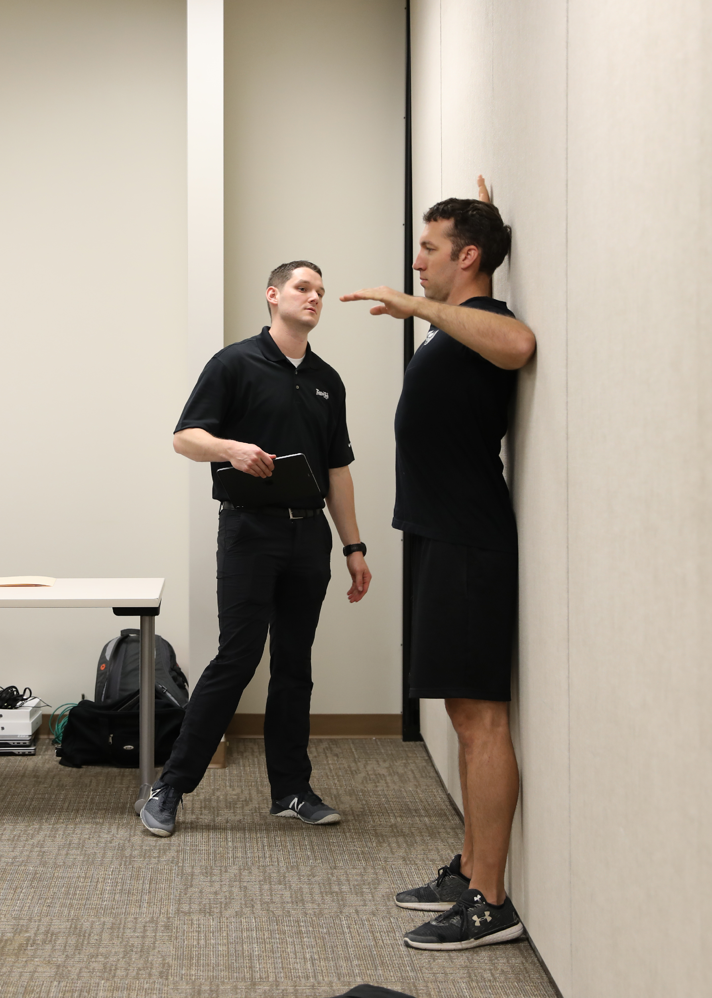

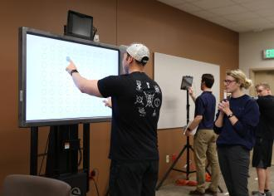
Study Background/Rationale Statement of Problem
Warfighters can experience a multitude of physical and cognitive stressors leading to performance degradation after returning from deployment. This cognitive degradation has been loosely linked to physical injury, sleep disturbances, and behavior complications termed “red line” events, such as alcohol abuse, suicide, and divorce, however there is a lack of comprehensive evaluation directly linking these events to neurocognitive and psychological degradation. To address this issue, a program called Comprehensive Operator Readiness Assessment (CORA) was implemented for 3rd SFG(A) at Fort Bragg as a holistic one-day physical and mental assessment to help identify and mitigate performance-degrading factors. While the CORA program provides great value through its one-day assessment, there is no existing program that effectively and continuously measures the degradation of the Warfighter
3rd Special Forces Group: CORA Stations
Sleep Assessment: Wearable Actigraphy
Grip Strength: (Strength & Conditioning)
ANAM Neuro-cognitive Feedback: (Performance Psych)
DiSC Personality Profile (Op Psych)
Body Composition: InBody® (Dietitian)
Movement Assessment & Injury Screen: (Sports Med)
Resiliency Chat: (Chaplain, Social Worker, Clinical Psych)

Slide 3
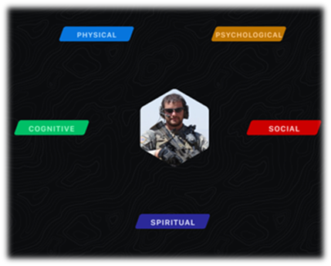
Study Background/Rationale Statement of Problem
The CBC has developed a customized iOS app + watch, that allows for continuous data collection and interventions including nutrition, musculoskeletal injury prevention and treatment, sleep hygiene, mindfulness, alcohol inventory, behavioral health, etc. This methodology will expand on information that may have been unobserved or unreported during the in-person CORA. Recent research has shown that continuously collected digital data can provide a more comprehensive overview of a person’s health and can improve intervention protocols and enhance patient outcomes.
“In a population that does not readily self-identify for illness, injury, or personal struggle, how do we craft a deliberate, individualized strategy to identify and address concerns, prevent degrading factors, maximize career longevity, and preserve the Soldier and Family”
-COL Nathan Prussian, Commander 3rd Special Forces Group-

Slide 4
Research Question(s) and Hypotheses
The overall objective of the proposal is to investigate whether “red-line” behavioral events (e.g., injury, suicide, divorce, DUI, etc.) specifically, or overall warfighter degradation more generally, can be predicted from daily continuous measures of physical and mental behavior.

Slide 5
Design and Methodology
Trial design | Observational study
Participants | 100 Soldiers 3SFG (A), Fort Bragg, NC & 100 Reconnaissance Marines, Camp Pendleton, CA
Outcomes | Physical and cognitive performance, self-reported mental health, nutrition, etc.
Implementation | In person study enrolment by CBC
Statistical methods | Machine learning for prediction and classification
We aim to scale the CORA program by transforming it into a confidential, cybersecure research mobile application that will digitize the existing measures of the program, as well as collect continuous measures of warfighter physical, cognitive (e.g., spatial memory, working memory, motor activity), and lifestyle factors (e.g., alcohol intake) over a six-month period. In conjunction with data collected via the mobile app, wearable sensors will be used to collect physiological, metabolic (e.g., ketones, lactate, glucose), and other data (e.g., heart rate, activity, sleep), continuously during their six-month study. In addition to collecting data, the app will have the capability of delivering behavioral intervention and other helpful features, such as nutrition, meditation and mindfulness features. Subjects will receive weekly status reports with a summary score based on a composite of the app features.

Slide 6
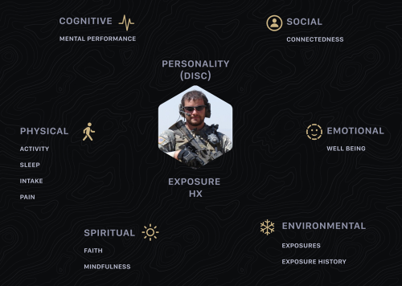

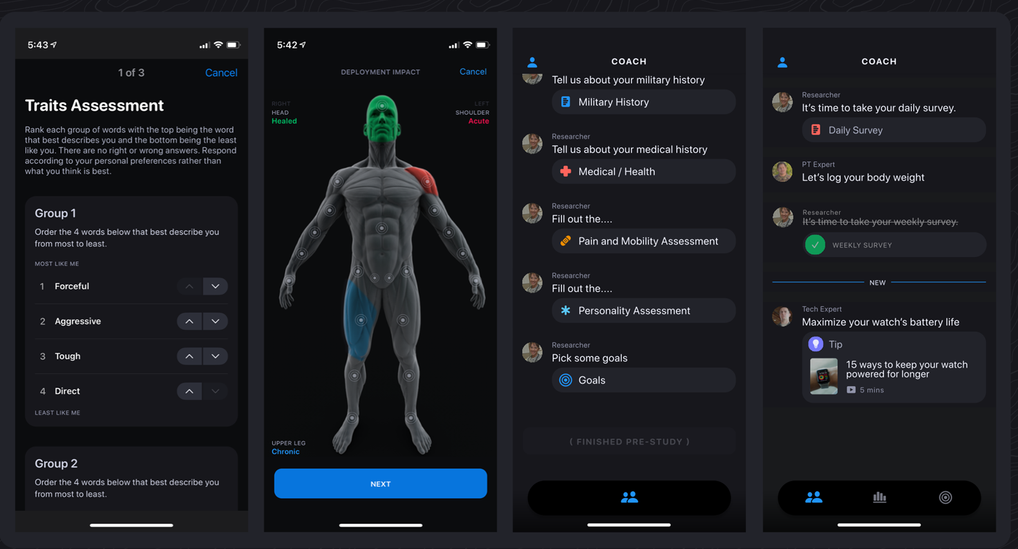
In person CORA
1-Day Assessment
RED
AMBER
GREEN
Digital CORA Continuous over 6 months

Slide 7
Study Progress
Regulatory Approvals
USC Social Behavioral Institutional Review Board (IRB) reviewed your project and was APPROVED on 11/20/2020.
In approving this research, the IRB determined that all of the requirements under 45 CFR 46.111 were satisfied. Study ID UP-20-00927
Progress / Accomplishments
Digital CORA application is complete, has been beta tested, and ready for study launch. The app will require additional updates as the study progresses.
Study hardware (200 watches and phones) have been prepared and shipped to the respective research team point of contact at study locations.
Partners from 3rd Special Forces Group and 1st Reconnaissance Battalion have had continual input into app development to ensure that the app will be well adopted by research subjects.
Research staff have been coordinating with unit leaders for optimal study launch timeline.

Slide 8
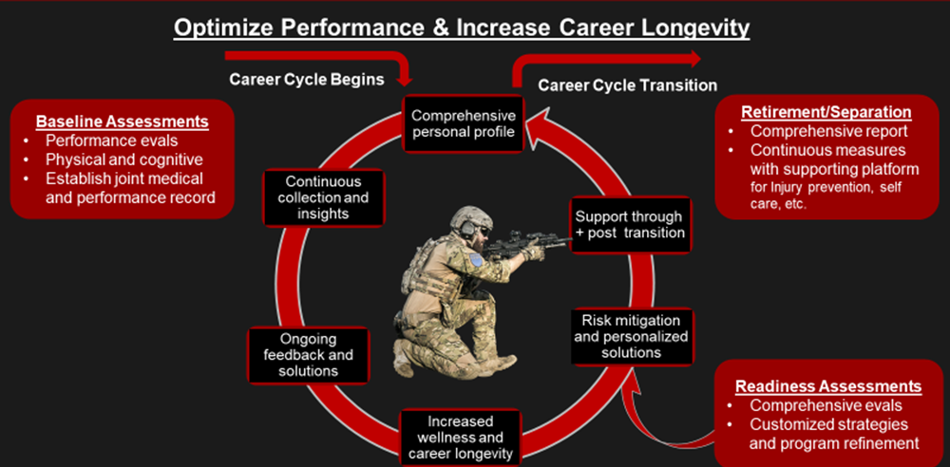
Deliverables
Digital CORA: multidisciplinary digital solution that can be immediately leveraged in any military setting.
Comprehensive (e.g., neurocognitive, psychological, physiologic, and lifestyle) longitudinal health and human performance platform.
Establish comprehensive performance baselines.
Insights needed to develop personalized, evidence-based solutions to restore and enhance performance.
Increase warfighter self-knowledge on methods to improve cognitive and physical performance.
A robust injury prevention and educational platform
Summary reports of user testing, feedback, and major findings of mental/physical factors that contribute to warfighter degradation
Predictive models to identify early signs of mental/physical change
Expected impact / return on investment
improve warfighter and unit readiness and resilience by optimizing training and operations methods and service policies and procedures.

Slide 9
Current and Anticipated Challenges
Issues: Due to COVID restrictions, we have pushed study enrollment from January 18, 2021, to February 15, 2021.

Slide 10
Dissemination/Transition Plan
Transition to USSOCOM following phase II (if approved)

Slide 11
Follow on Work
To build on the objectives of Phase I and address these issues, we propose the following objectives: Improve, expand, and personalize Digital Cora mobile app based on Digital Cora Phase I study findings, and: (1) offer continued use to participants from Phase I; (2) recruit new participant cohorts.
Expand platform to support more warfighters by expanding support for additional operating systems (i.e. Android, iOS) and additional wearable sensors.
Facilitate an encrypted and secure method for service members to: (1) consolidate human performance data collected in the Digital Cora app with other military service and medical records; (2) share the data collected in the Digital Cora app with other military apps that store military service or medical records.
Determine optimal strategy for summarizing and interpreting digital human performance data with the goal of providing an up-to-date summary and assessment tool for the individual.
Ensure an efficient transition of the Digital Cora app to operational units.

Slide 12
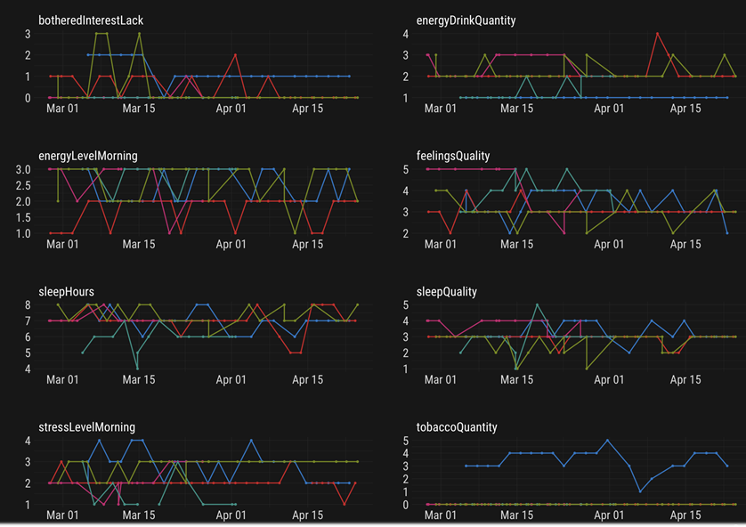
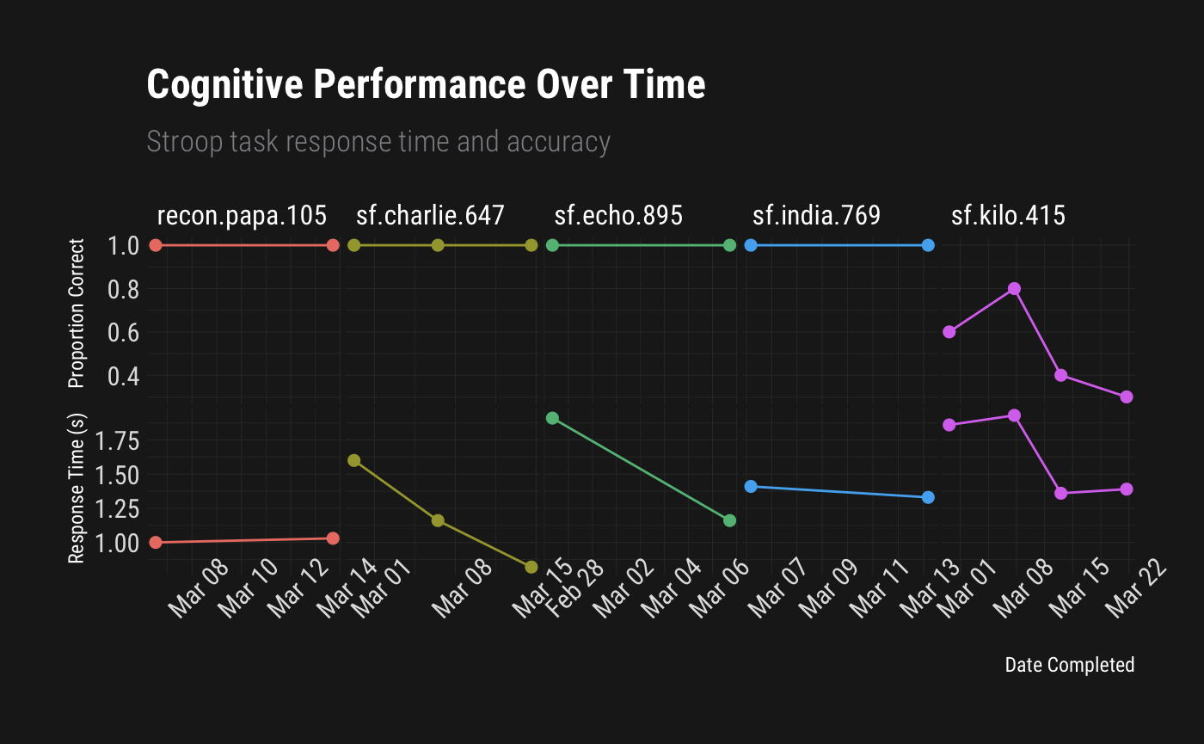
Results / Conclusions
This study period will provide 5,200 person-weeks of wearable sensor data with labels from daily surveys. Combining with health, military, and other records will enable development and training of machine learning models for predicting users’ wellbeing and physical and mental health risks as related to warfighter readiness.
Sample of Daily Questionnaire Responses: Each question is displayed in a different panel and each user is a different colored line. This data this will help identify changes and trends in how they respond over time.
Stroop Task (executive control)
Notes:
Cognitive performance is evaluated during each weekly survey which will allow us to look at trends in operators’ cognitive performance over the course of the study. Cognitive skills assessed include attention, memory, visual-motor, and executive control. This plot shows performance over time from five beta testers on the Stroop task: the most well-known test of executive control. We expect faster reaction times and higher accuracy rates as users re-take and become more familiar with each repeated weekly cognitive skills test. Here we see the expected trend for most users showing faster consecutive reaction times, however sf.kilo’s accuracy is clearly deteriorating over time.

Slide 13
THANK YOU

